Slide 1
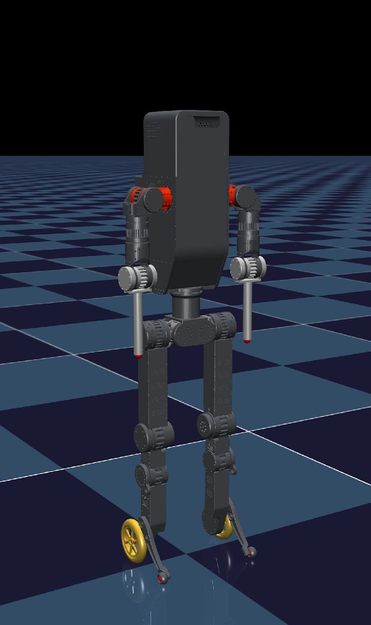
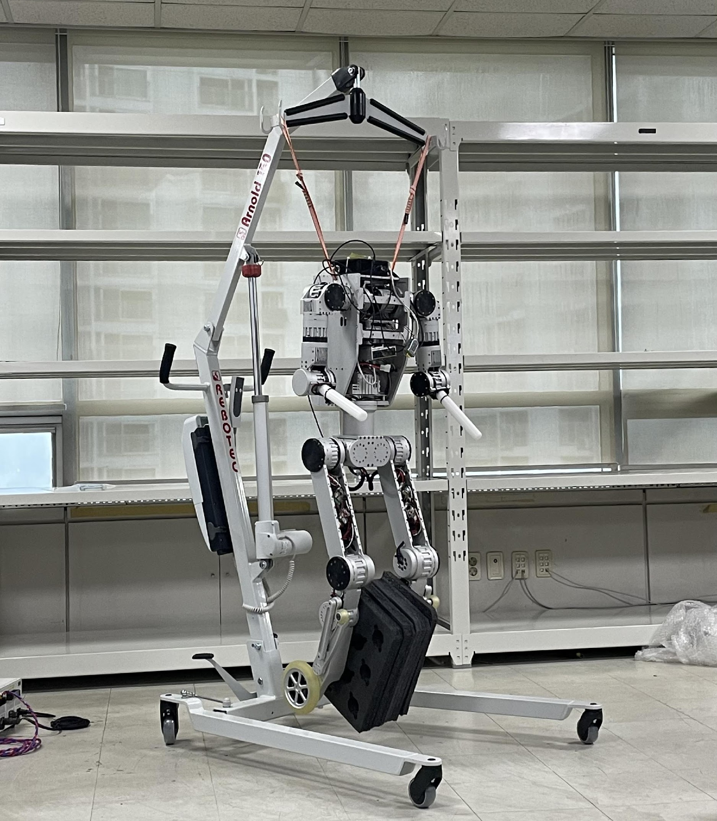
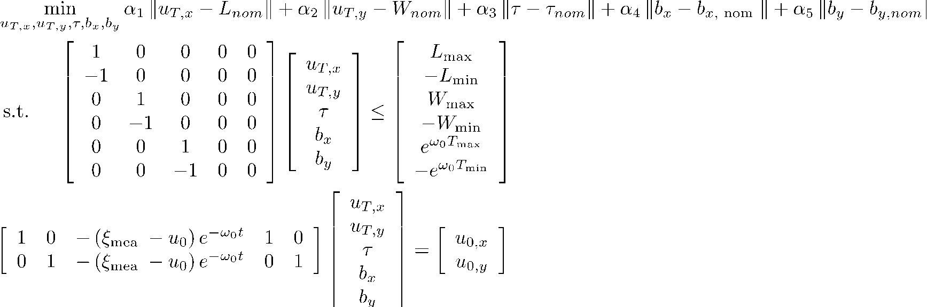
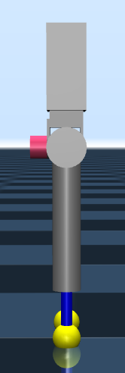
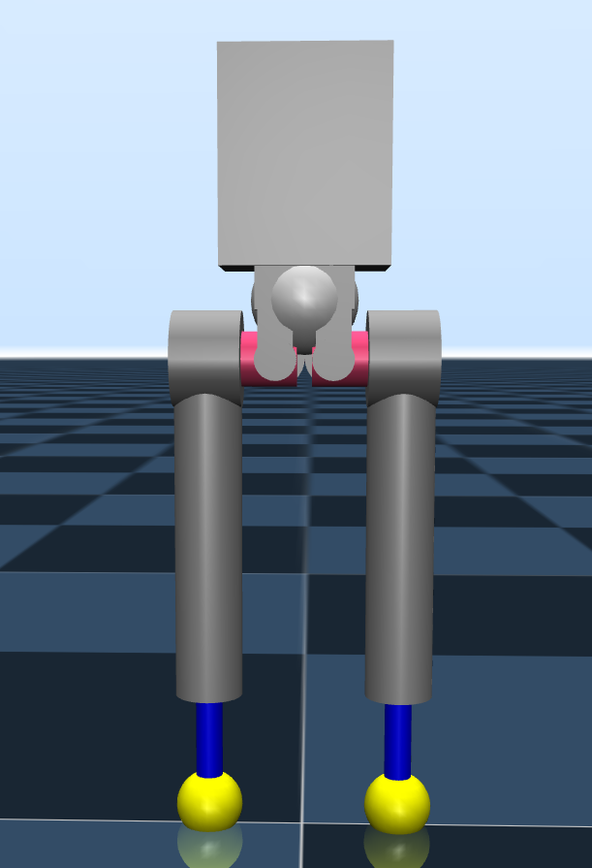
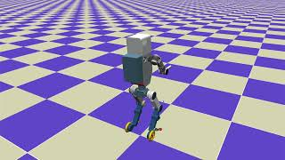
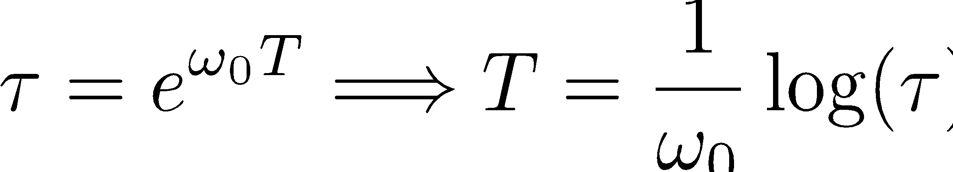
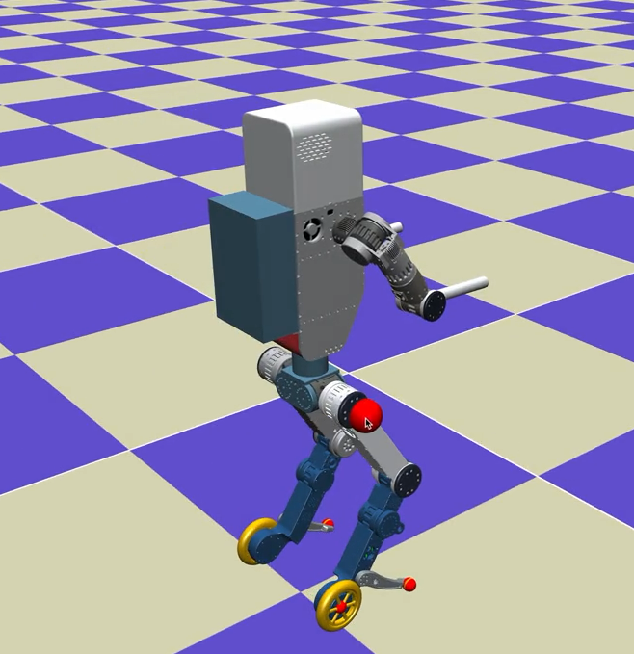
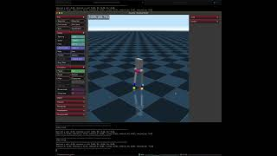
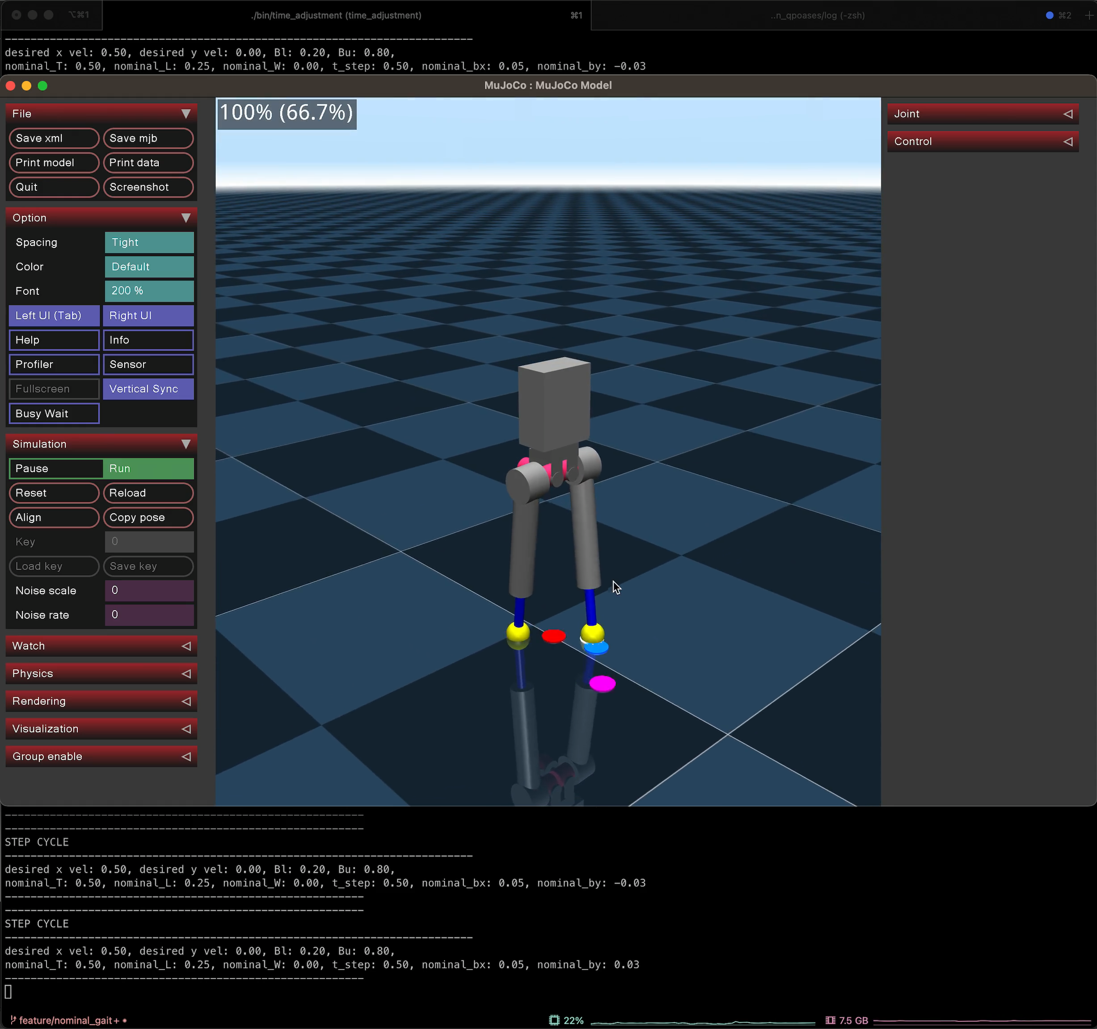
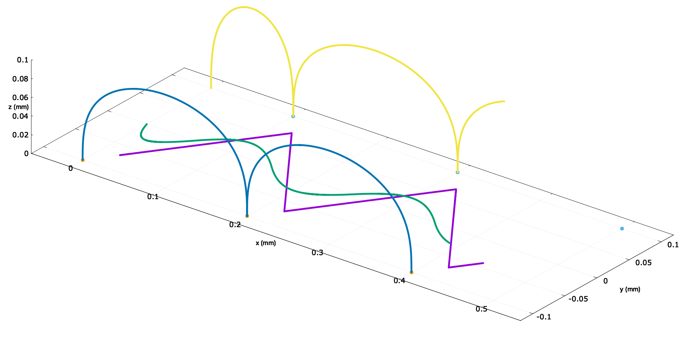
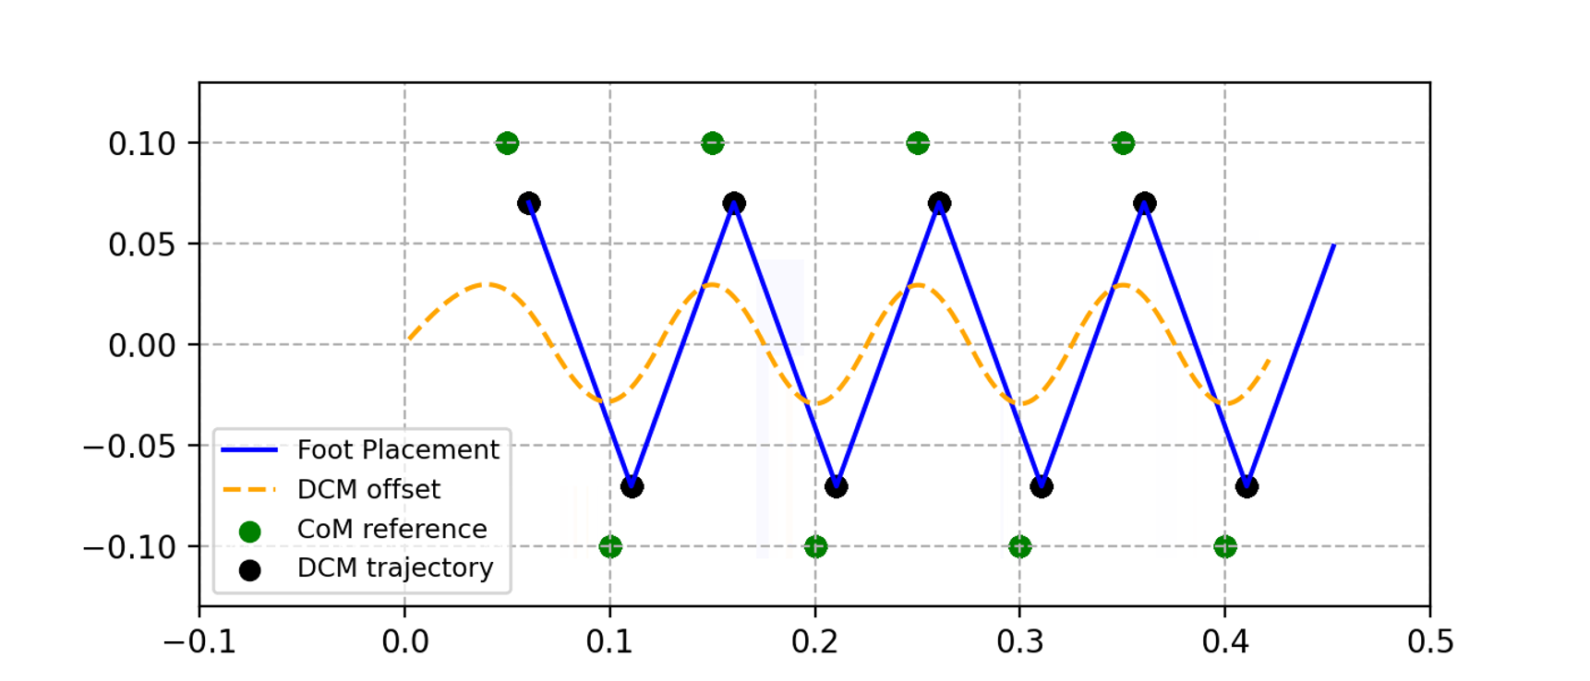
Wheel Legged Humanoid
Dynamic Locomotion for the Wheel Legged Humanoid Robot
Wheel Legged Humanoid Robot Model
Optimization-based Foot Step Planning w/ template model
MuJoCo
QP Formulation ( reference paper )
Template Model ( pointfoot )
0.78m
MAHRU_WL
0.2m
Optimization-based Whole Body Controller
Step duration
Landing location
0.5m
0.25m
Prismatic range : 0 – 0.25
CoM, DCM, Swing foot(L,R) Trajectory
Squat Motion using WBC, w/ 4 contact point (video)
Robot walking in generated gait pattern,
(Constrainted roll, pitch, yaw) (video)
DCM-based Walking Pattern Generation(video)
Page 1

